Slide 1

PROPAGANDA NEWS CLASSIFICATION USING ML & DEEP LEARNING TECHNIQUES
– Seshadivya Batlanki, Sonia Mann
TUESDAY● NOVEMBER 8● 2022

Slide 2

AGENDA
01.
02.
INTRODUCTION
ABOUT DATA
03.
04.
ANALYSIS
CONCLUSION
Description,Literature review and Objective of the data
Output class analysis,Data cleaning,Word cloud Analysis and Encoding Methods
Machine learning models ,Deep learning models and comparisons
Future work & Research
TUESDAY● NOVEMBER 8● 2022

Slide 3
Introduction
Propaganda spreads the ideology and beliefs of like-minded people, brainwashing their audiences, and sometimes leading to violence.
Propaganda news looks like the original news and it’s very difficult to identify as it is written very carefully.
As the increase in social media use, there are many platforms and sources trying to populate their propaganda and feed to the people.
It is important to identify such texts, articles before it spreads like wildfire
TUESDAY● NOVEMBER 8● 2022

Slide 4
1.2 Literature Review
From 2014 to 2017, the European Commission supported the three-year PHEME research project, which examined NLP methods for handling rumor detection, stance detection, contradiction detection, and analysis of rumors on social media.
Social media sites make it simple to spread phony news items, but it is challenging to automatically detect fake information. Facebook investigates if machine learning classifiers might be useful to identify fake news by using information sources (Visual cues & Cognitive cues) and social judgment (Cognitive, Behavioral & Affective cues).
TUESDAY● NOVEMBER 8● 2022

Slide 5
1.3 Objective
The objective of the project is to classify/predict the propaganda based news, articles, and text using machine learning,deep learning classification techniques.
Propaganda based news are written very carefully and must be identified using NLP techniques and encoding methods.
Accuracy Metrics – Accuracy, F1 Score, Recall Score, Confusion Matrix, Classification Report.
TUESDAY● NOVEMBER 8● 2022

Slide 6

2. About Data
No null values and duplicate rows present in the dataset.
All input text are articles, and text data.
No null values and duplicate rows present in the dataset.
All input text are articles, and text data.
No null values and duplicate rows present in the dataset.
All input text are articles, and text data.
TUESDAY● NOVEMBER 8● 2022

Slide 7
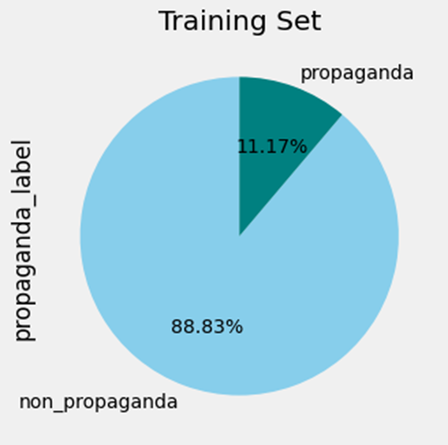
2.1 Output class analysis
Output Class is binary.
Highly imbalance.
Only 11.17% has propaganda labels present in each dataset. (train, validation, and test)
TUESDAY● NOVEMBER 8● 2022

Slide 8

2.2 Data Cleaning and Text pre-processing
Below are the steps being performed as a part of text preprocessing.
1.Lowercasing each row
2.Deconstruction of English words (ex : can’t – can not)
3.Removal of special characters and punctuations
4.Removal of numbers and digits
5.Removal of stop words
6.Lemmatization of each word in each row
TUESDAY● NOVEMBER 8● 2022
Notes:
Stop words are a set of commonly used words in a language. Examples of stop words in English are “a”, “the”, “is”, “are” and etc. Stop words are commonly used in Text Mining and Natural Language Processing (NLP) to eliminate words that are so commonly used that they carry very little useful information.
Lemmatization usually refers to doing things properly with the use of a vocabulary and morphological analysis of words, normally aiming to remove inflectional endings only and to return the base or dictionary form of a word,

Slide 9
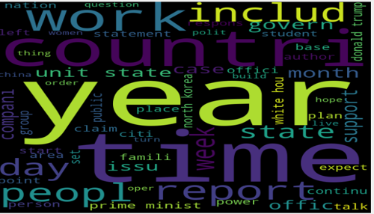
2.3 Word cloud Analysis (Non-propaganda class)
TUESDAY● NOVEMBER 8● 2022

Slide 10
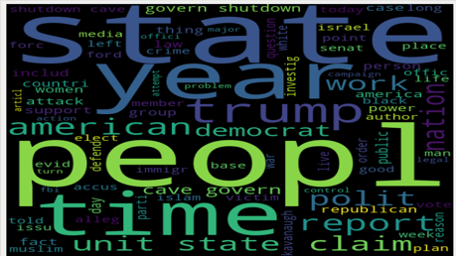
Word cloud Analysis (Propaganda class)
TUESDAY● NOVEMBER 8● 2022

Slide 11
2.4 Encoding Methods
Two types of encoding methods being applied with same set up.
1.Count Vectorizer
2.tfIdf Vectorizer
Setup:
1.n grams = unigram, bigram, trigrams
2.Minimum reparation of words = 10
3.Maximum reparation of words = 95% of maximum word count
TUESDAY● NOVEMBER 8● 2022

Slide 12
3. Analysis -Feature Selection
Total Features generated from encoding methods are – 141,451 (141.4K)
To reduce the features drastically used K-Best Method with Chi2 test.
Final Features Selected - 100
TUESDAY● NOVEMBER 8● 2022

Slide 13
3.1 Machine Learning Models Considered
1.Gaussian Naïve Bayes
2.Bernoulli Naïve Bayes
3.Weighted Logistic Regression (with balanced weights)
4.Non-weighted Logistic Regression
5.Decision Tree Classifier
6.Random Forest
7.Ada Boost Classifier
8.XGBOOST Classifier

Slide 14
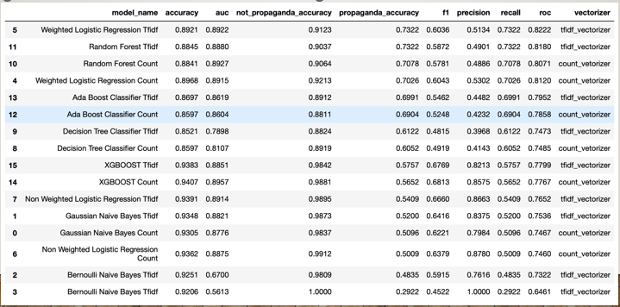
Machine Learning models output comparison
TUESDAY● NOVEMBER 8● 2022

Slide 15
Model output comparison (CNTD.)
Selection Criteria (Based on Imbalanced Class) – High Recall Score, followed by high AUC score and F1 Score
The best model output from the 16 models is – Weighted Logistic
Regression
Recall Score – 73.22%
Accuracy, AUC – 89.22%
Vectorizer – tfidf
No overfitting
TUESDAY● NOVEMBER 8● 2022

Slide 16
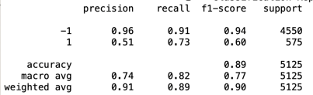
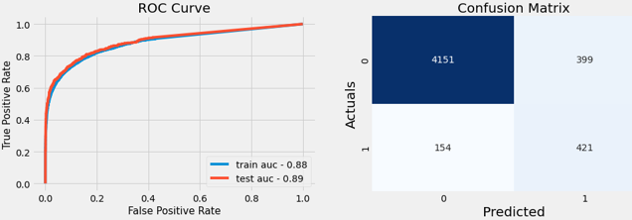
Weighted logistic regression
TUESDAY● NOVEMBER 8● 2022

Slide 17
3.2 Deep Learning Models Considered
1.LSTM based Model
2.GRU based Model
3.Conv-LSTM Based Model
4.Conv-GRU Based Model
5.BERT Model (bert_en_uncased_L-12_H-768_A-12)
TUESDAY● NOVEMBER 8● 2022

Slide 18
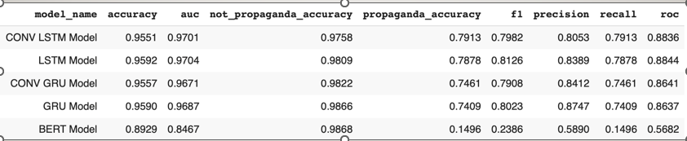
Deep Learning models output comparison
TUESDAY● NOVEMBER 8● 2022

Slide 19
Model output comparison (CNTD.)
Selection Criteria (Based on Imbalanced Class) – High Recall Score, followed by high AUC score and F1 Score
The best model output from the 21 models is – Conv LSTM Model
Recall Score – 79.13%
Accuracy, AUC – 97.58%, 97.01%
No overfitting
TUESDAY● NOVEMBER 8● 2022

Slide 20
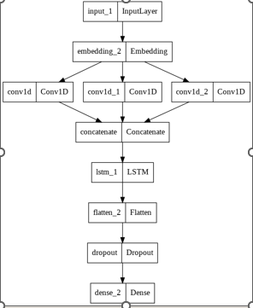
Summary of Conv-LSTM Model
TUESDAY● NOVEMBER 8● 2022

Slide 21
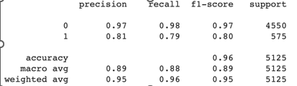
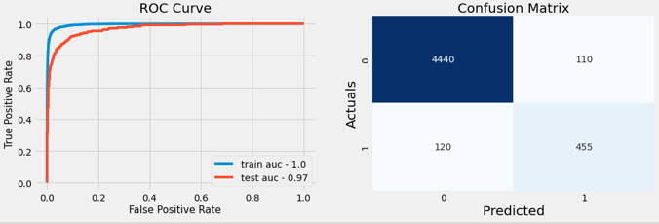
Output of Conv-LSTM Model
TUESDAY● NOVEMBER 8● 2022

Slide 22
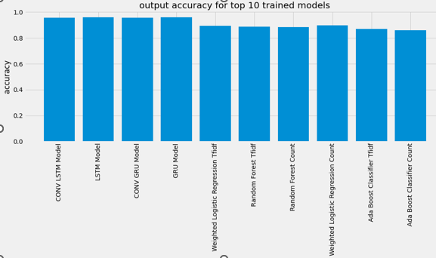
3.4 Top 10 Best Models
TUESDAY● NOVEMBER 8● 2022

Slide 23
4. Conclusion and Future Works
Best Model – Convolutional-LSTM based Deep Learning Model
The overall output accuracy – 97.58%
FUTURE WORKS:
The dataset can be further utilized for more better results using pre-trained embeddings such as word2vec, fasttext, etc.
TUESDAY● NOVEMBER 8● 2022

Slide 24
THANKYOU!
TUESDAY● NOVEMBER 8● 2022

